Slide 1

Predictive Models Project
Presented to: Marco Bijvank
December 6, 2022
Daniel Jovanovic
Rupin Sehgal

Slide 2
Table of Contents
1
Introduction
2
Task 1 – General Approach
3
Task 1 – Best Model & Results
4
Task 2 – General Approach
5
Task 2 – Best Model & Results
1

Slide 3
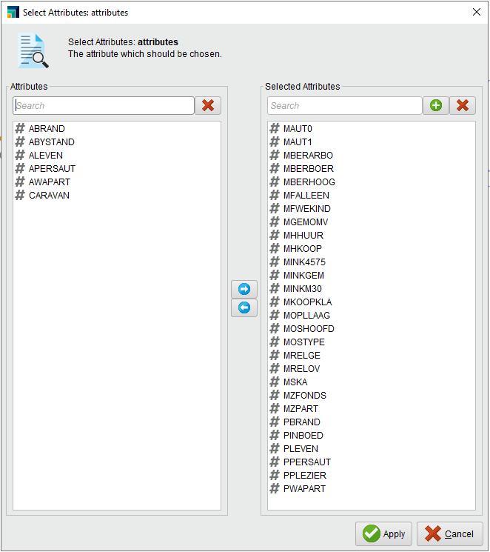
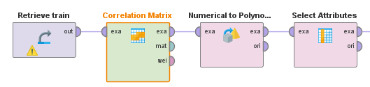
Task 1 – Data Mining & General Approach
Data Mining
General Approach
Correlation matrix was used to identify attributes with at least a +/- 0.05 correlation with the target attribute
Resulted in only meaningful attributes being included in our process, and reduced computational requirements
All attributes were initially registered as integers, and some of them needed to be changed
The "Numerical to Polynomial" operator was utilized for this
AUC was chosen as the main performance criterion
Accuracy wasn’t used as it only performs well when classes are distributed equally
Sensitivity wasn’t used as it doesn’t account for specificity (increased false negatives)
Normalization was included where appropriate
Throughout our process we experimented with:
Various model parameters trained through optimization
Different threshold values trained through optimization
Stratified vs. Shuffled sampling
Cross validation
2
Notes:
Minimizes false positives & minimizes false negatives

Slide 4
Task 1 – Different Models That Were Built
Task 1 Model Development
= Validation AUC
Decision Tree
= 0.692
Naïve Bayes
= 0.763
SVM
= 0.648
KNN
= 0.733
Neural Net
= 0.762
Logistic Regression
= 0.802
Ensembles
= 0.750
3

Slide 5
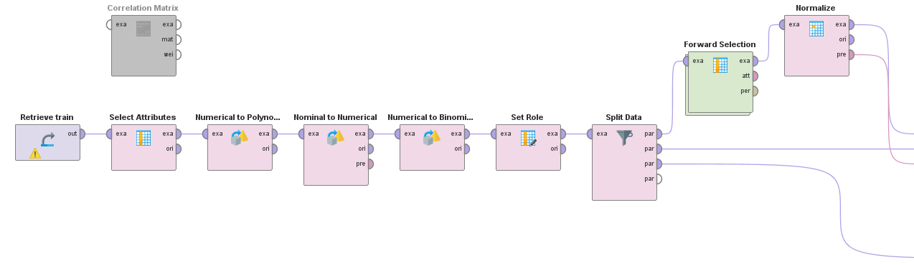
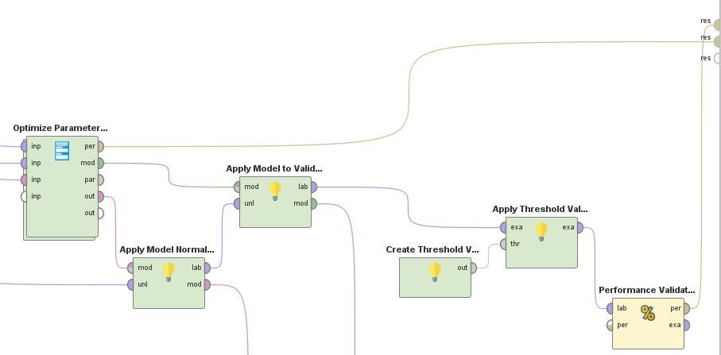
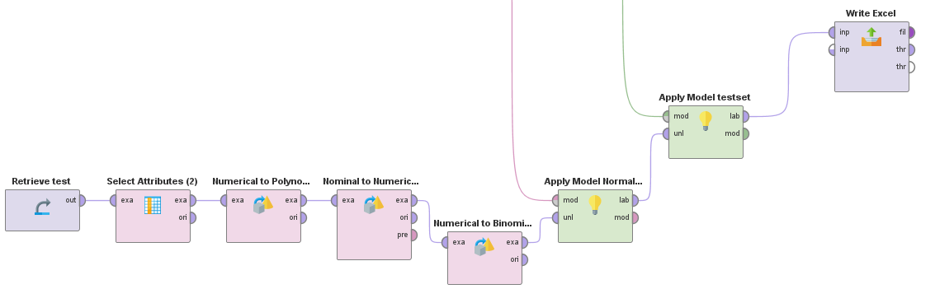
Task 1 – Best Model & Results
Logistic Regression
4

Slide 6
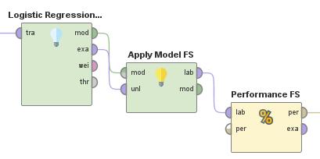
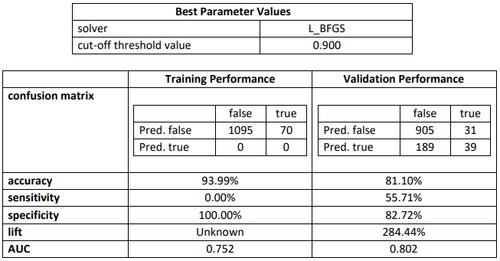
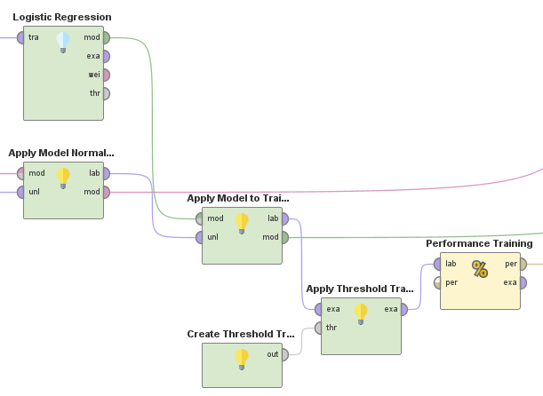
Task 1 – Data Mining & General Approach
Inside Forward Selection & Optimize Parameters
Logistic Regression Results | AUC = 0.802
Forward Selection:
Optimize Parameters:
The model was able to correctly select 127 out of 240 Caravan policy buyers
Correctly identified 53% of true customers
5
Notes:
Minimizes false positives & minimizes false negatives

Slide 7
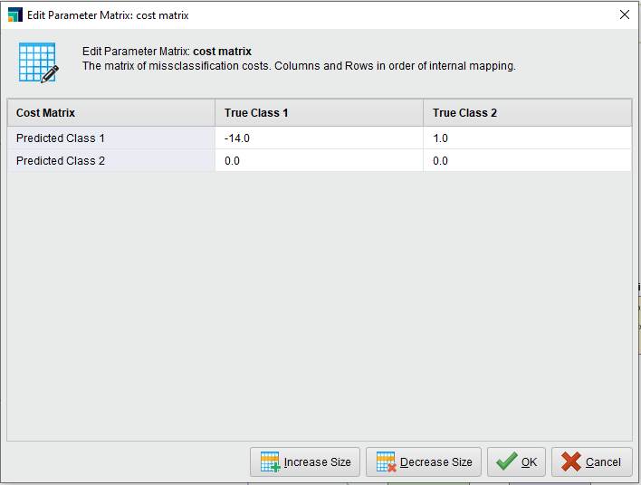
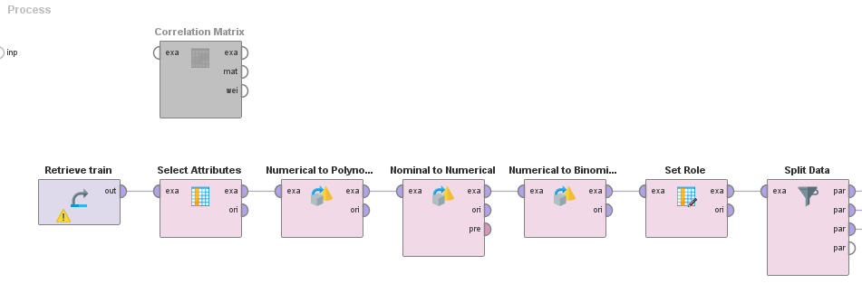
Task 2 – Data Mining & General Approach
General Approach
Misclassification cost was chosen as the main performance criterion
$1.00 of cost associated with classifying any record as a buyer
$14.00 of profit for correctly identifying a policy buyer
Once again, we experimented with the following:
Various model parameters trained through optimization
Different threshold values trained through optimization
Stratified vs. Shuffled sampling
Cross validation
6
Notes:
Minimizes false positives & minimizes false negatives

Slide 8
Task 2 – Different Models That Were Built
Task 1 Model Development
= Validation Misclassification Cost
Decision Tree
= -0.283
Naïve Bayes
= -0.255
SVM
= -0.114
KNN
= -0.294
Neural Net
= -0.302
Logistic Regression
= -0.307
Ensembles
= -0.279
7

Slide 9
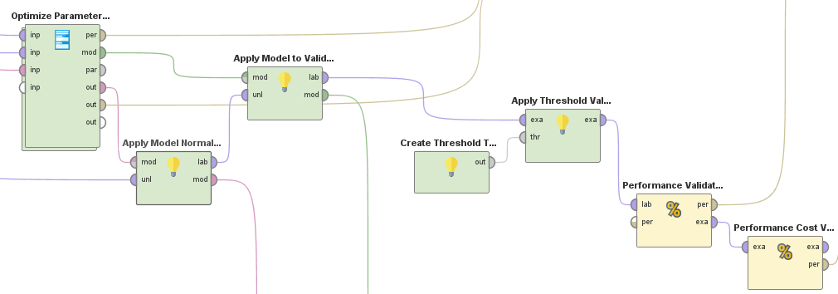
Task 2 – Best Model & Results
Logistic Regression
8

Slide 10
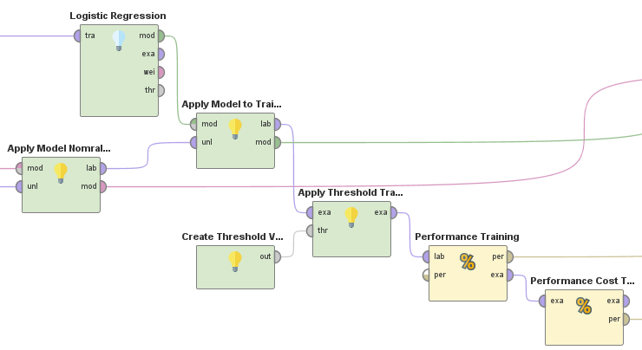
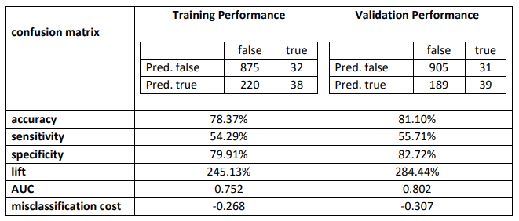
Task 2 – Data Mining & General Approach
Inside Forward Selection & Optimize Parameters
Logistic Regression Results | Misclassification Cost = -0.307
Forward Selection:
Optimize Parameters:
The model was able to correctly predict a profit of $867 out of a possible maximized profit of $3,360.00
Achieved 26% of potential profits
In our excel submission, we only selected record with a propensity score greater than 0.100
9
Notes:
Minimizes false positives & minimizes false negatives

Slide 11
Thank You!!!
Questions?
10

